Slide 1
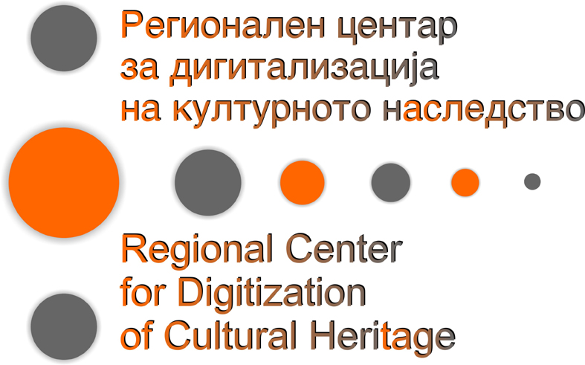

Slide 2
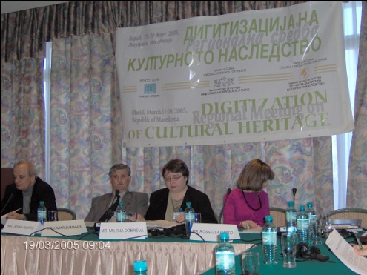
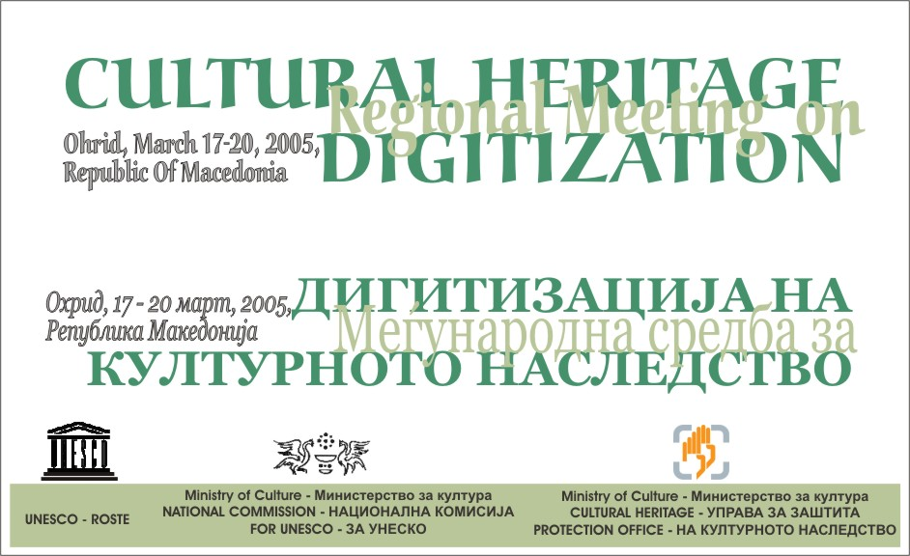
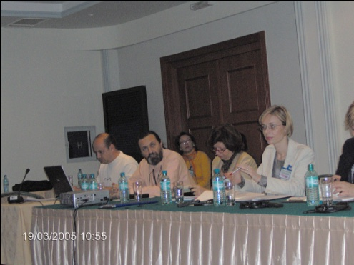
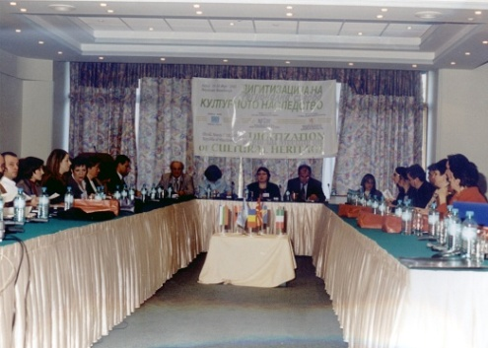
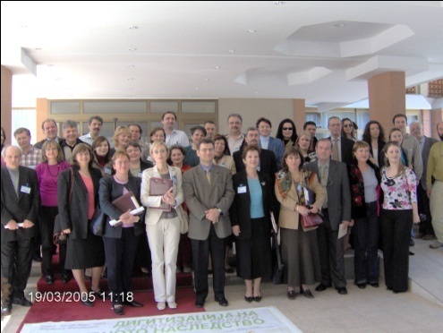

Slide 3
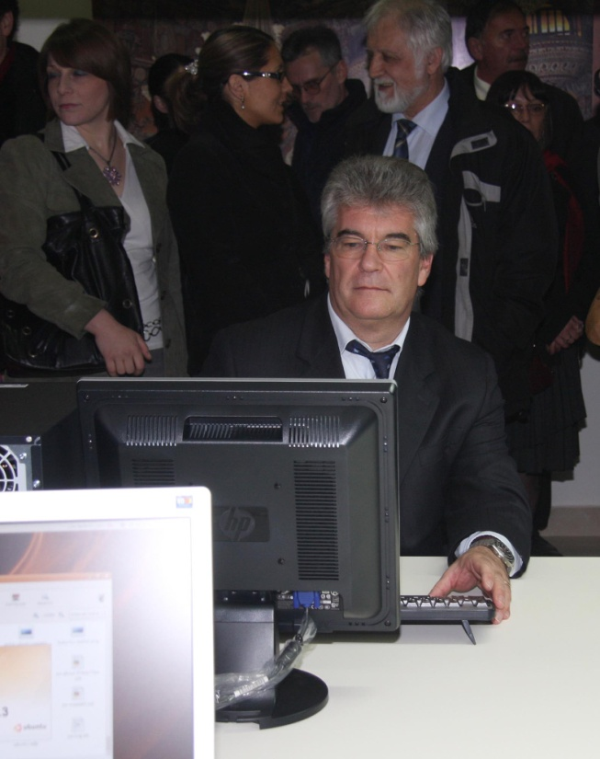
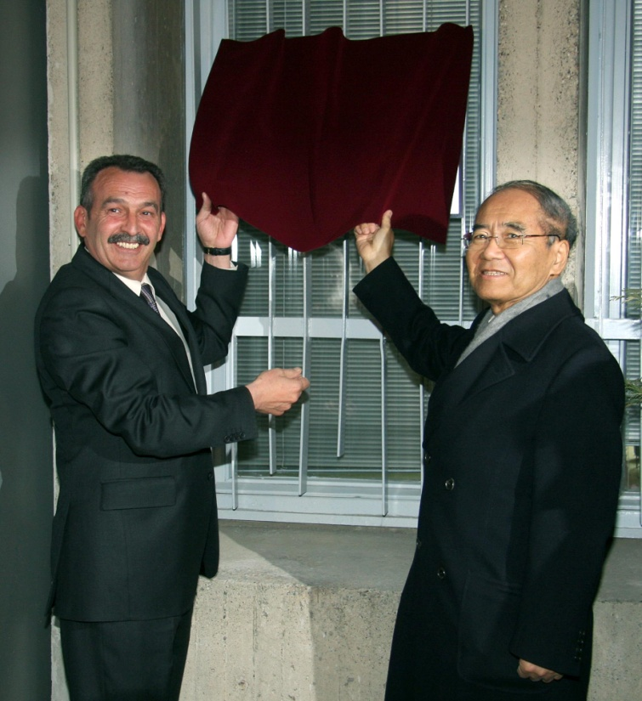
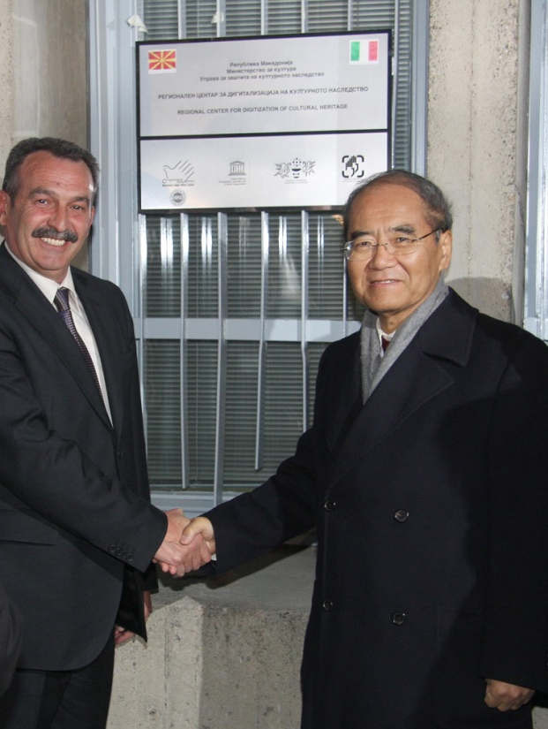
2008
Inauguration of the Regional Center for Digitization of Cultural Heritage

Slide 4
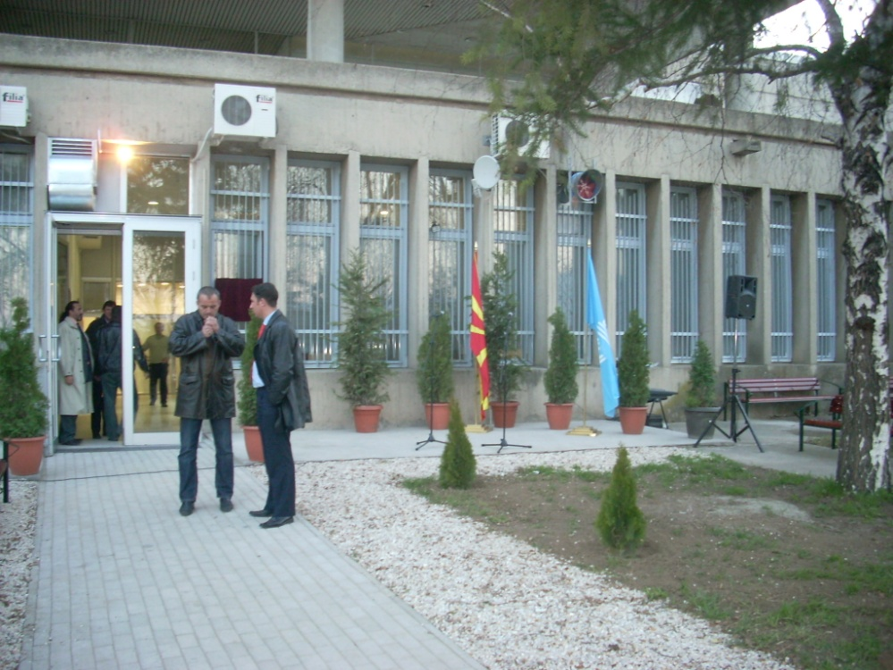
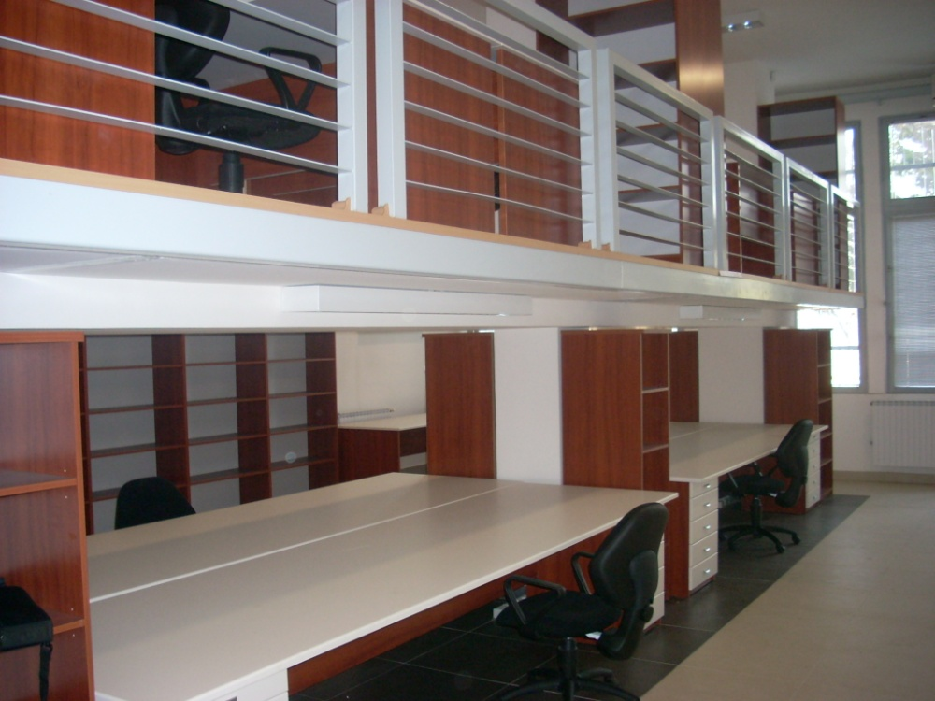
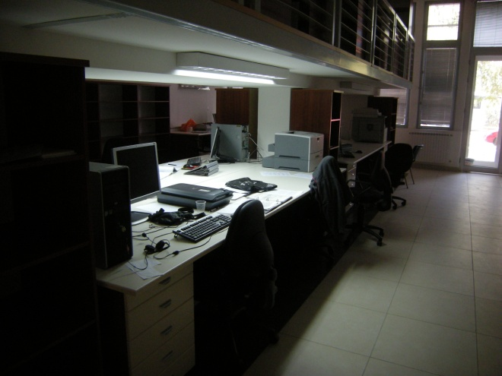
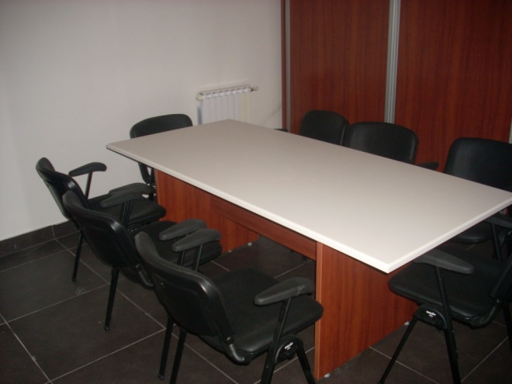
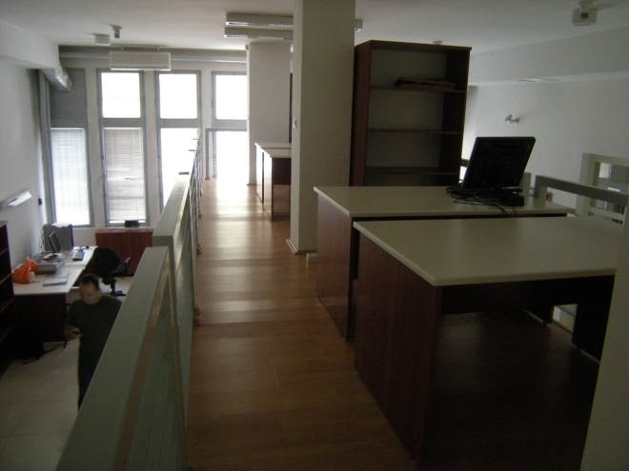
The premises of the Regional Center for Digitization of Cultural Heritage

Slide 5
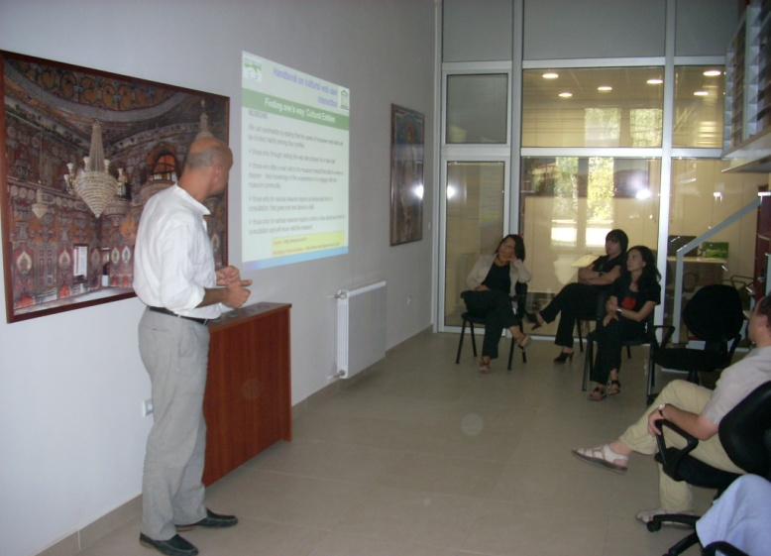
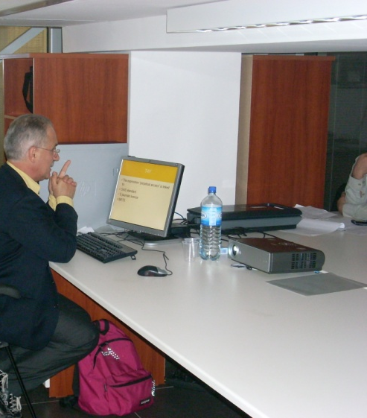
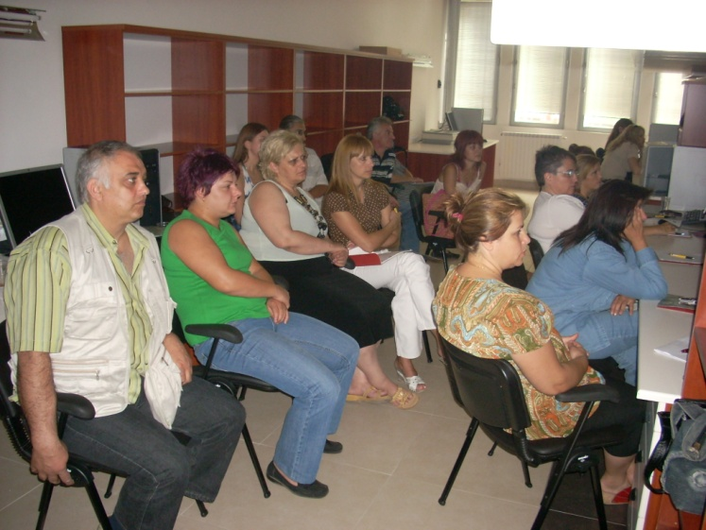
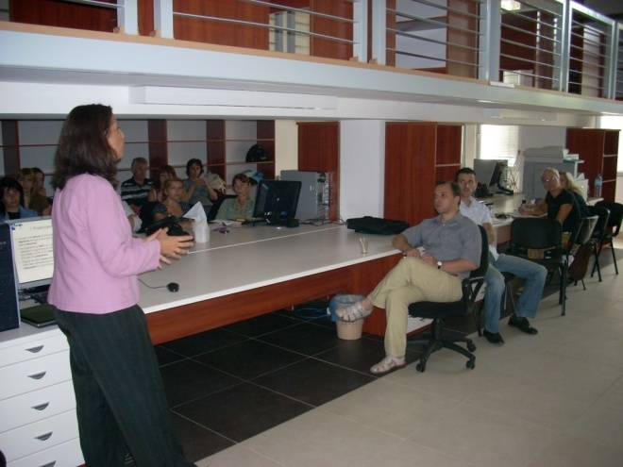
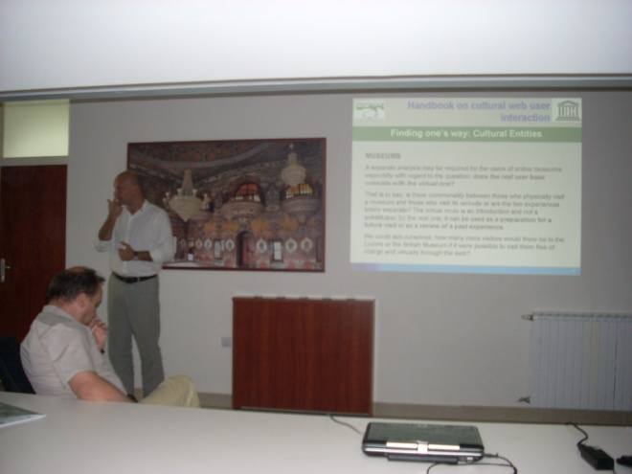
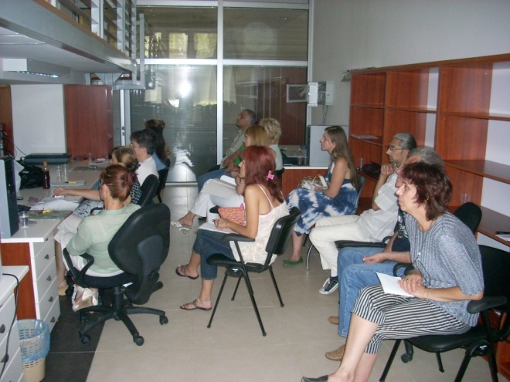
Training course on Digitization of Cultural Heritage - 2008

Slide 6
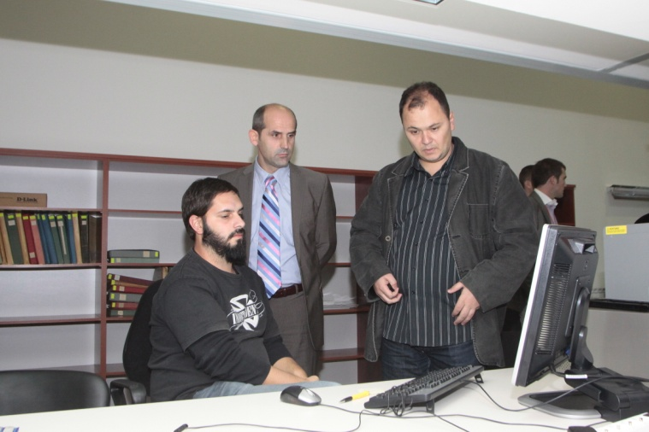
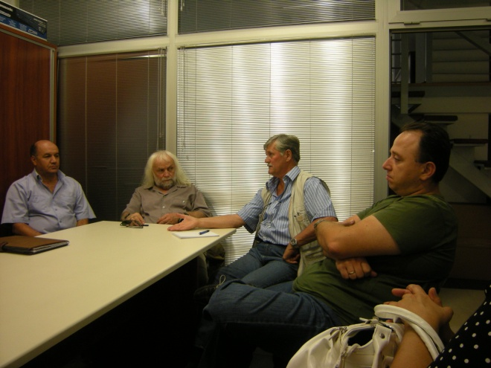
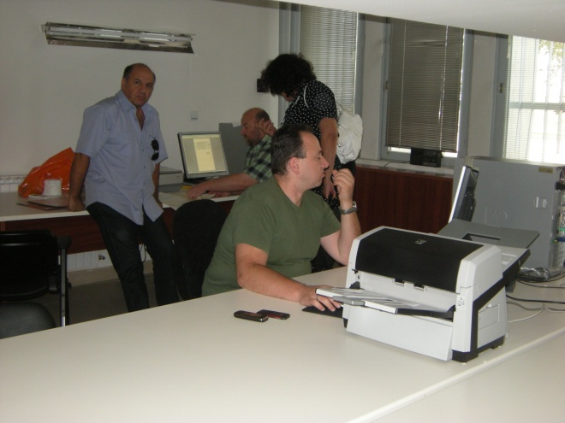
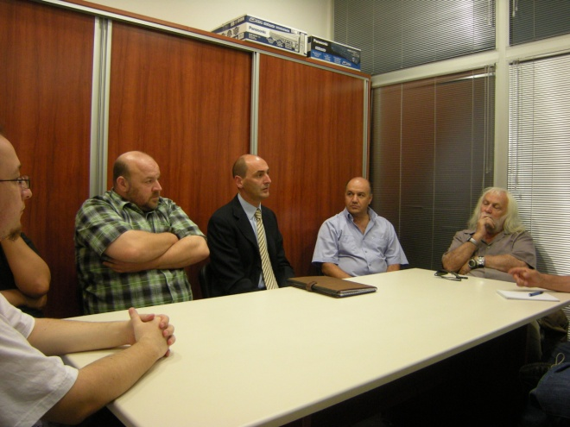
The staff employed in the Center

Slide 7
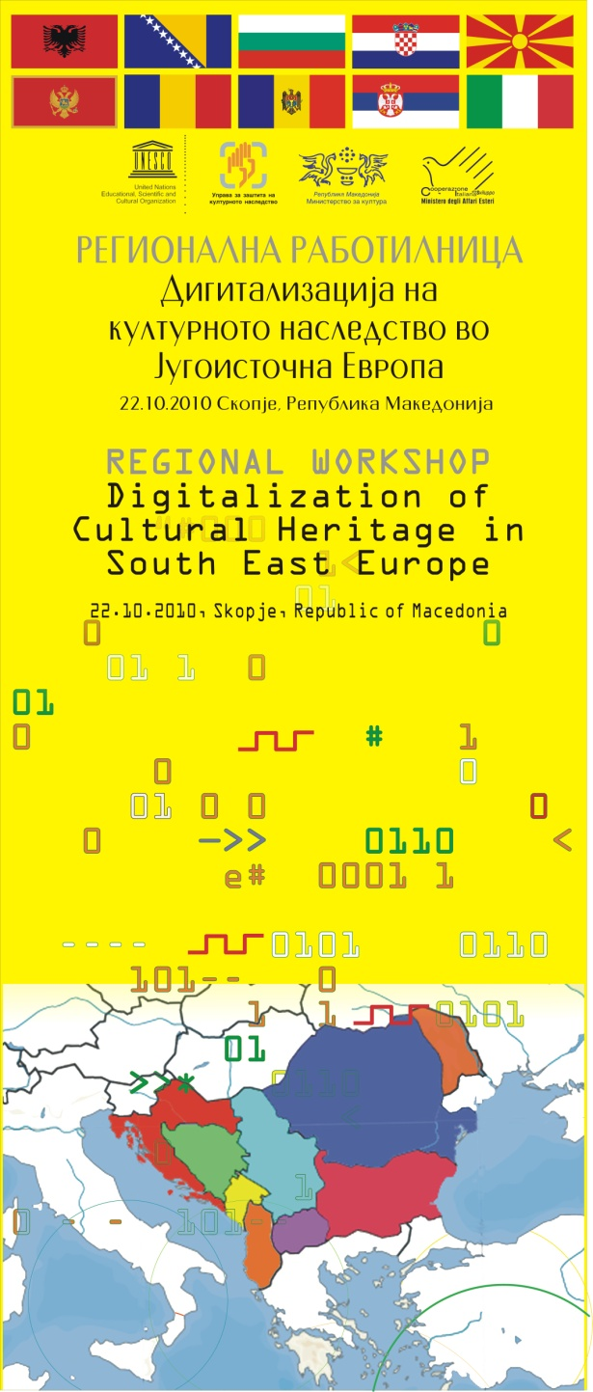
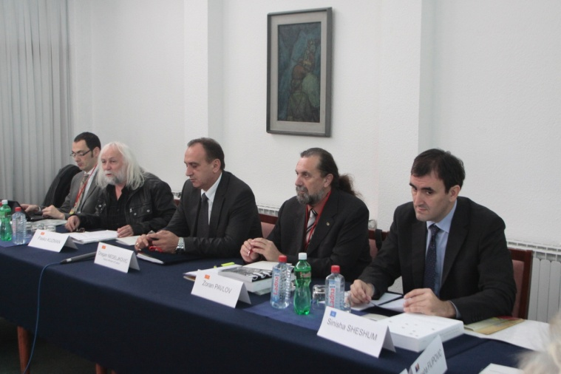
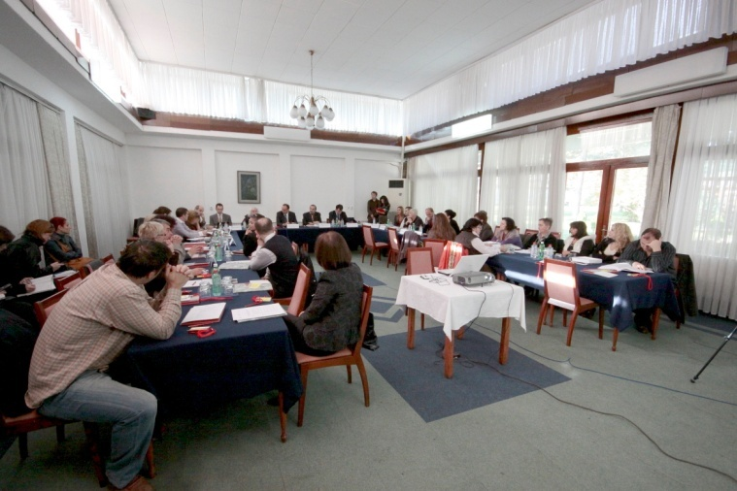
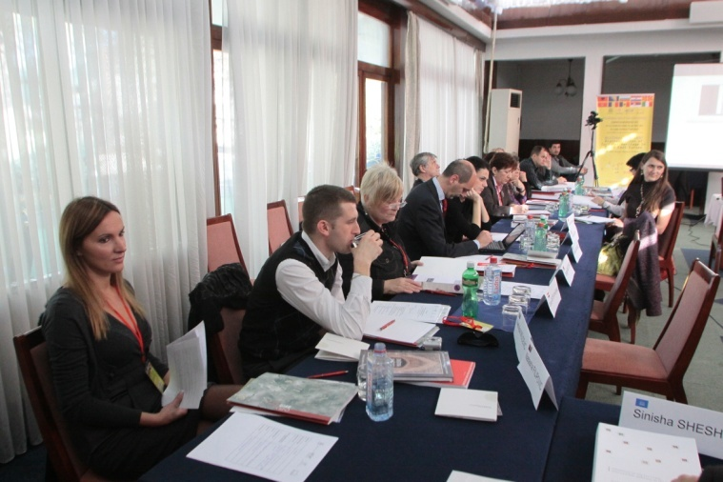
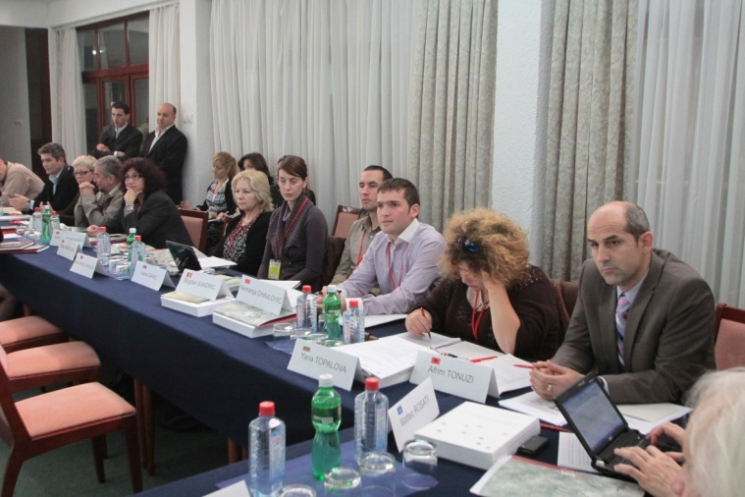
Regional Workshop
Digitization of Cultural Heritage in SEE
October 2010

Slide 8
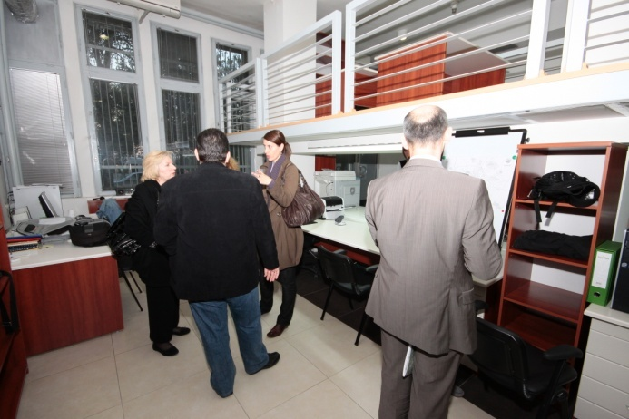
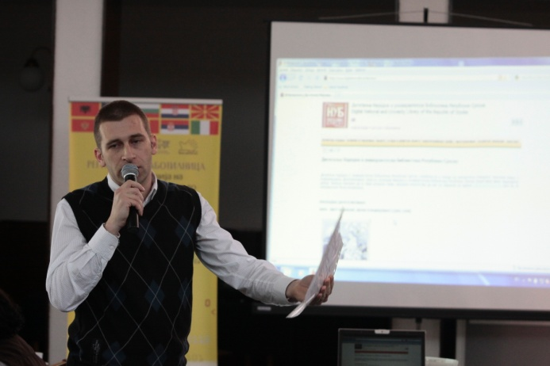
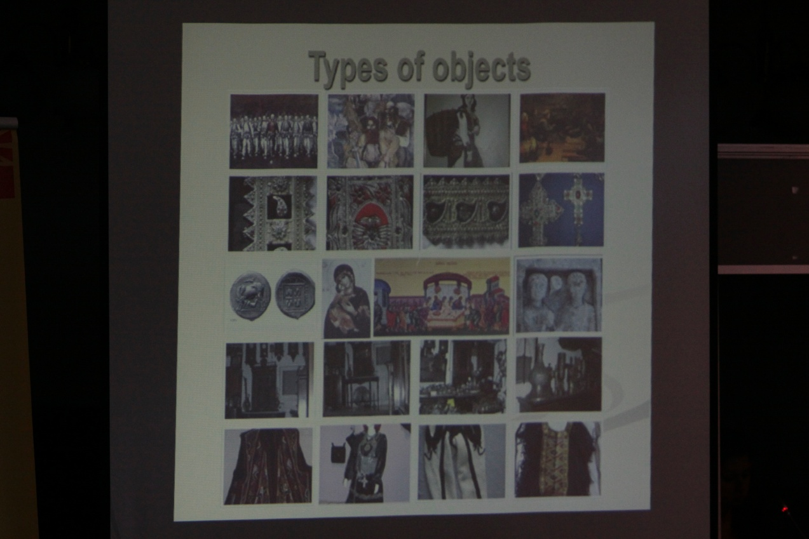
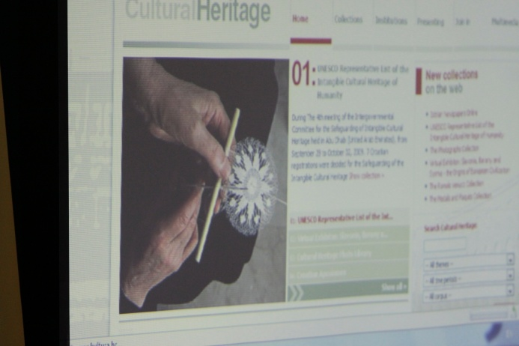
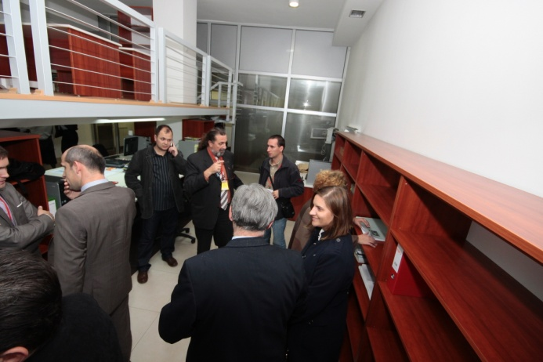
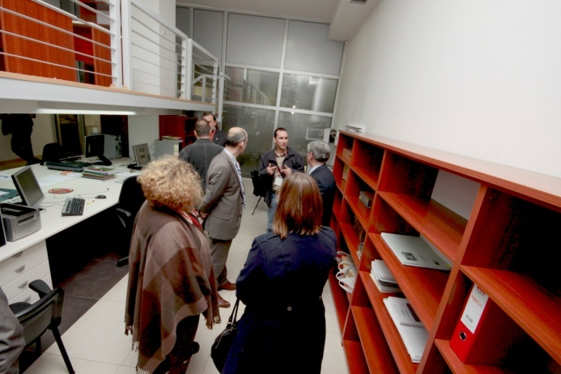
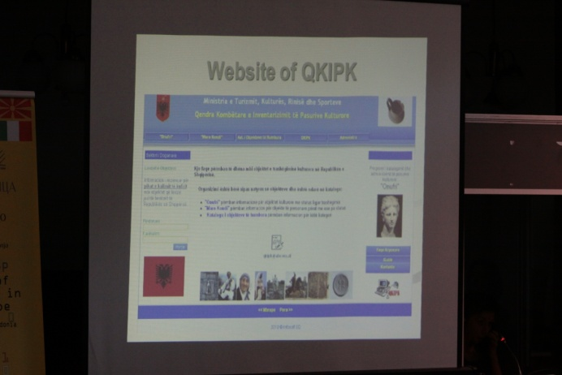

Slide 9
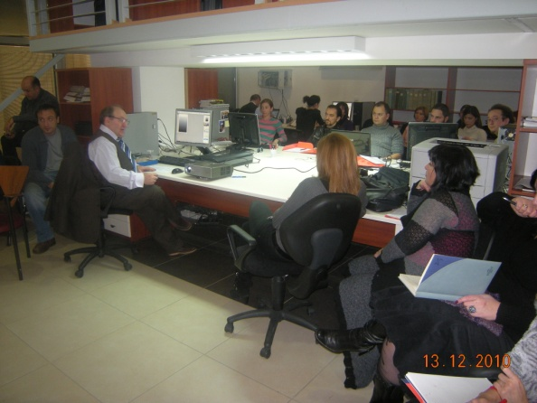
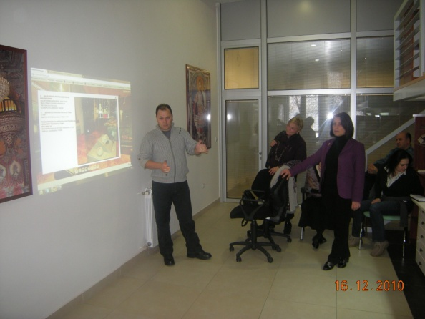
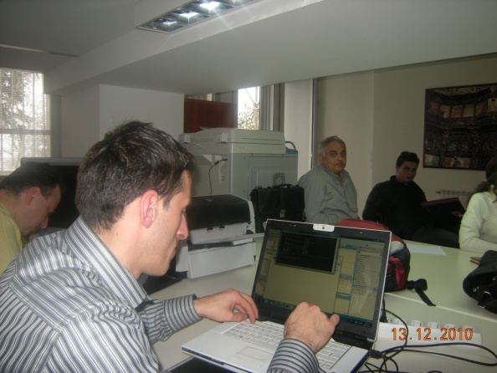
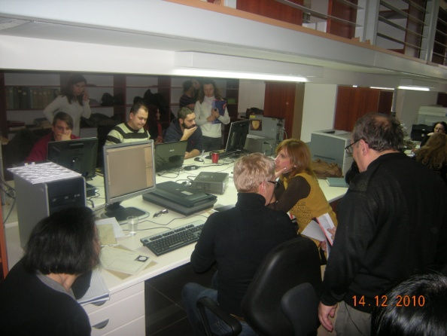
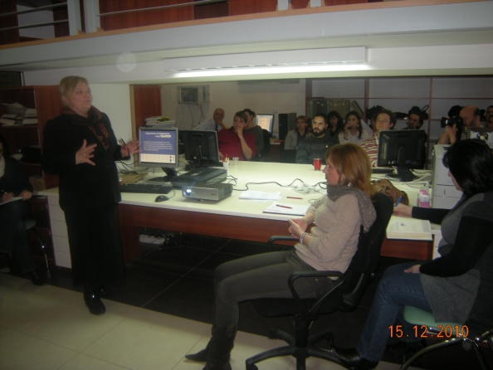
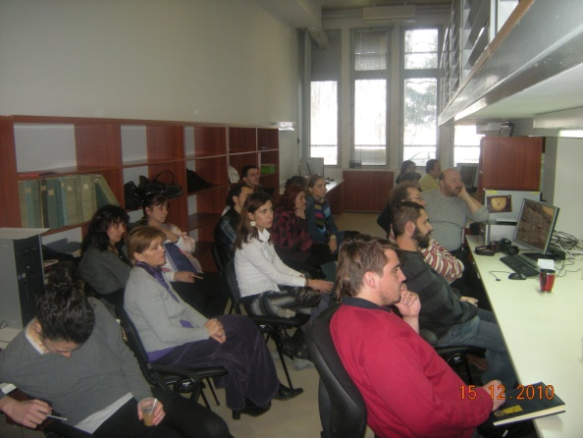
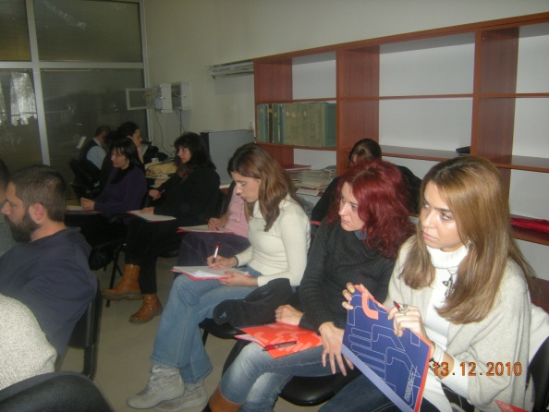
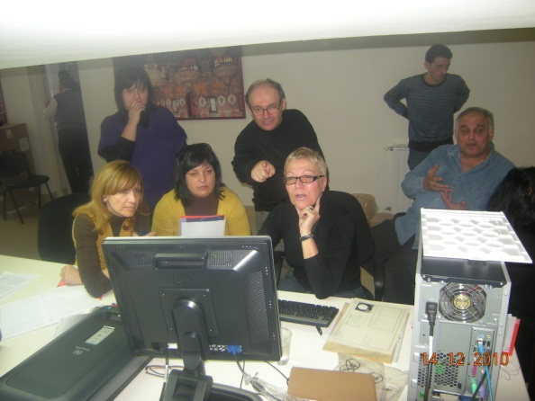
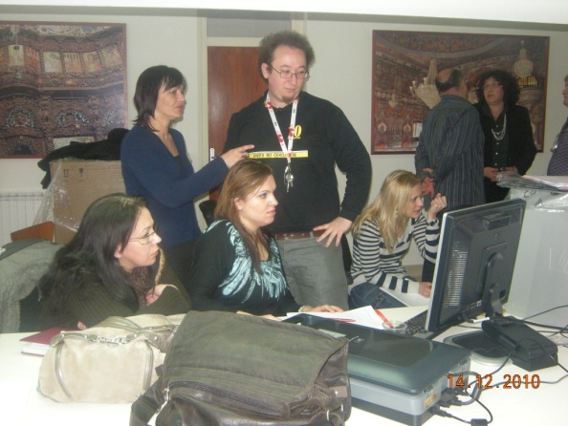
Training for the digitalization of the cultural heritage - 2010

Slide 10
General objectives
Monitoring of the state-of-affairs and necessities for digitization
Education – thematic trainings in the field of digitalisation of cultural heritage
E-learning
Creation of joint platform of recommendations, standards and guidelines
Quality web site
Education by organizing seminars, conferences, popular lectures, publications of brochures and / or other printed materials
Strengthening of the Regional cooperation in the field of culture with the SEE countries

Slide 11
In order to secure long-term success and economic sustainability, the digitalization initiatives should meet several preconditions:
Political and institutional strategies, and their adjustment;
Stronger coordination at national and better exchange at regional level at segments of policies, programmes and projects
Integration of the activities of the research and cultural institutions;
Establishment of guidelines and offering best practices
Monitoring and utilisation of global standards for digitalisation;
Persistence
Establishment of concrete relations and strengthening of communication, public awareness and cooperation with:
  Private sector
  Media
  Organizations for protection of the rights of intellectual property
  Tourism sector
  Civil sector
  Education sector
  Research and academic sector

Slide 12
Forming a Network of national representatives - experts from the countries of SEE
By officially nominated experts from each of the countries from SEE
Representatives from UNESCO-Venice Office
  To share the national experiences
  To build a joint platform of series of recommendations, guidelines, digitalization standards…
  Performing of periodical assessments on the progress of the digitalization processes by securing feedback to the involved parties.

Slide 13
Regional Centre for Digitalisation of Cultural Heritage, through regional and international cooperation will enable:
expanding, enriching and promoting of the digitalisation process in the region
sharing of knowledge and good practices
increasing the awareness and understanding for the existent international standards, recommendations and guidelines
strengthening of the development of the regional process of coordination
training in digitalisation of cultural heritage
improvement of the protection and promotion of cultural heritage in SEE, through development of the capacities of the institutions and experts

Slide 14
Expected results
Establishment of the Regional Center as a platform for discussion, coordination and alignment of the national measures and strategies for digitization of the cultural heritage in the countries of south-eastern Europe;
The creation of joint platform for exchange and discussion of the positive experiences and recommendations concerning the digitization, standardization, longevity of the data-base and preservation of the cultural web-sites.
Aid for the countries of south-eastern Europe in order for them to improve their approach and enhance their awareness. This process will usher these countries in the common global cultural space;
Education – training and exchange of experts in the field of digitization of the cultural heritage;
Appropriate protection of the valuable cultural heritage in the countries of south-eastern Europe.

Slide 15

Ministry of Culture of the Republic of Macedonia – Cultural Heritage Protection Office
Thanks for your attention!
  Zoran Pavlov MA
  z.pzvlov@uzkn.gov.mk

